Slide 1




IT
PROJECT
iSORT - The Sorting Visualizer
Presented by Rishabh Chopra

Slide 2




﻿About Us
The Sorting Visualizer project is a software application.
The project aims to provide a comprehensive understanding of various sorting algorithms.
The understanding is offered through a visual representation.
Main Objectives:
Visual representation for better understanding
User Friendly
Interface
Fun Learning Experience
Good Analysis Tool

Slide 3
Let’s Access The Site
https://rishabhchopra223.github.io/Sorting_Visualizer/

Slide 4
﻿Background
Sorting algorithms are an essential aspect of computer science and play a crucial role in data processing and analysis.
The visualization of sorting algorithms is an effective way of understanding how these algorithms work.
The Sorting Visualizer project aims to provide a visual representation of various sorting algorithms to enhance understanding and analysis.
This project uses web technologies, including HTML, CSS, and JavaScript, to create an interactive user interface that enables users to observe and compare sorting algorithms.
Notes:
hello

Slide 5



1
Challenges with Current Systems
﻿Table Of Contents
2
Our Tools of Choice: A Look at the Tools We Use
3
Overview of the Website
4
Our available sorting methods
5
Alternative Tools for Project Development
6
Projecting Forward

Slide 6

Problems with Existing Sytems
The existing system for sorting visualizers is manual
Lacks a visual representation of sorting algorithms.
They are however not user-friendly .
Most of the functionality is hidden in sidebars.
Mostly limited to text-based outputs.

Slide 7





How We Utilized Tools in Our Project: A Comprehensive Overview

Slide 8
JAVASCRIPT & JQUERY FUNTIONS USED
const container = document.querySelector(".vrsplit1");
const pausePlayBtn = document.getElementById("pauseButton");
function generatebars(num)
container.innerHTML={....}
const barLabel = document.createElement("label");
container.appendChild(bar);
const value = Math.floor(Math.random() * 80) + 1;
await new Promise((resolve) => setTimeout(() => { resolve(); }, delay));
document.getElementById("Button3").style.backgroundColor = "#a54997";

Slide 9

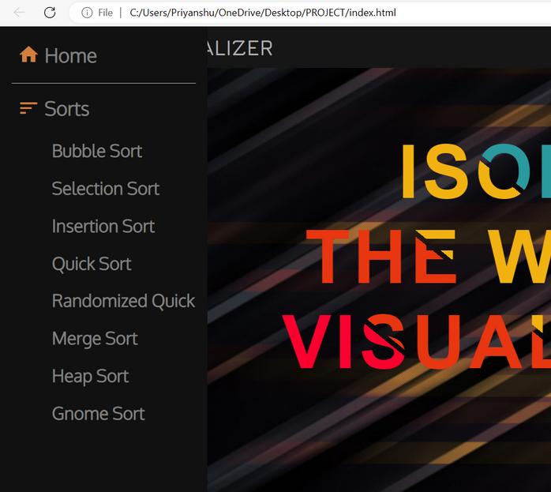
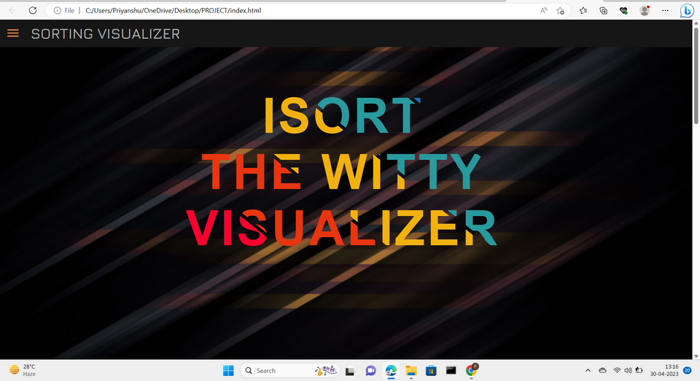


About The Project
It is a Software application to provide a comprehensive understanding of various sorting algorithms through visual representation.
Working Of Project

Slide 10


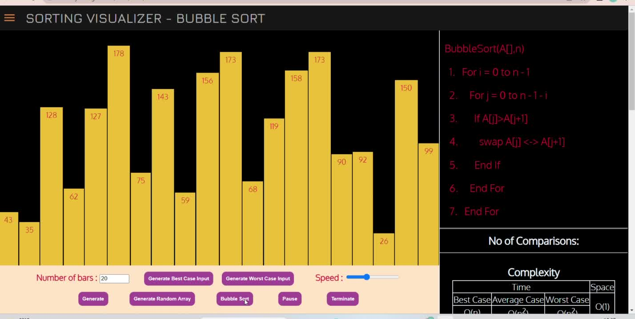

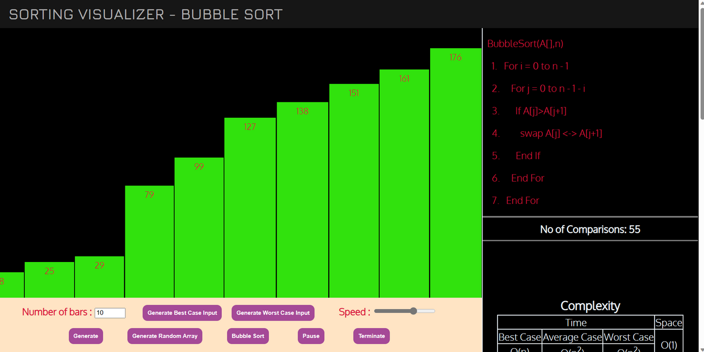

Sorted Data with no. of comparisons
Sorting the data

Slide 11






Beyond the Basics: Supplementary Tools for Project Development

Slide 12
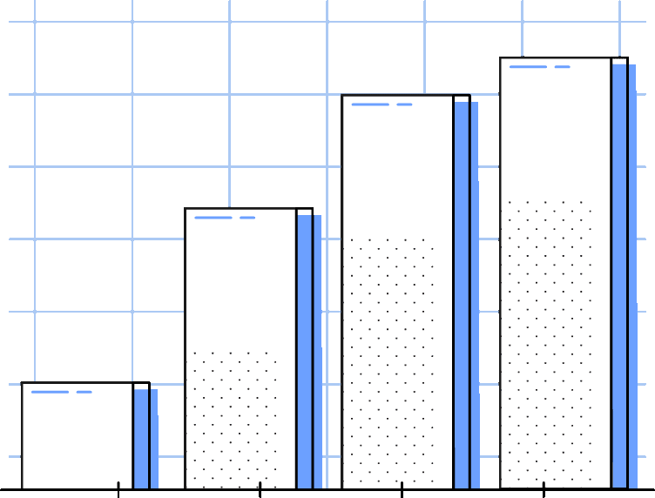





Future Work
Adding more Sorting Techniques
Testing the visualizer with real-world data
Implementing more advanced visualization techniques
Optimization of the code
Adding sounds to sorting visualizers.

Slide 13
﻿THANK YOU
BY - RISHABH CHOPRA

